Slide 1




CISC3025
Project Report
MAI JIAJUN, D-C1-27853
GUO PENGZE, D-C1-2746
25-APR-2025

Slide 2

Content
01
Brief of project
02
Methodology
03
Challenges
04
Presentation & Conclusion
Named Entity Recognition

Slide 3

-01-
BRIEF OF PROJECT

Slide 4
1.0 Brief of projecf
This project identifies the names of people in the text through the Maximum Entropy Markov Model (MEMM), relying on feature engineering and the maximum entropy classifier for training and prediction. It is capable of making word-by-word predictions for the input sentences and can save and load the best model for subsequent applications
Frontend
Backend
Gradio interface
Gradio is used to quickly build Web interfaces, allowing users to interact with models through sliders, text boxes and buttons
This interface is divided into two tabs. One is for training and visualization, and the other is for sentence prediction.
This code implements a named entity recognition (NER) system based on the Maximum Entropy Markov Model (MEMM). It can train a model to identify named entities in the text by extracting text features and return the label of each word when making predictions. During the training process, the model will be evaluated based on indicators such as accuracy and recall rate, and ultimately the best model will be saved for subsequent use

Slide 5
-02-
METHODOLOGY

Slide 6

ABOUT METHODOLOGY
early stop
probelm
The early stop mechanism is a regularization approach that monitors a certain validation set metric (such as loss or accuracy) during model training. When the performance on the validation set does not improve after several consecutive rounds, the training can be prematurely terminated.
train method does not support incremental learning
cause it is too old！
how about save and load？？
No way either.
The training cannot read the previous model parameters

Slide 7

GRADIO UI
About Gradio
Gradio is an open-source Python library that allows developers to quickly build and share customizable web interfaces for machine learning models and data processing functions. It enables users to interact with models in real-time through a simple GUI, making it ideal for demos, testing, and sharing models without needing complex front-end development.

Slide 8
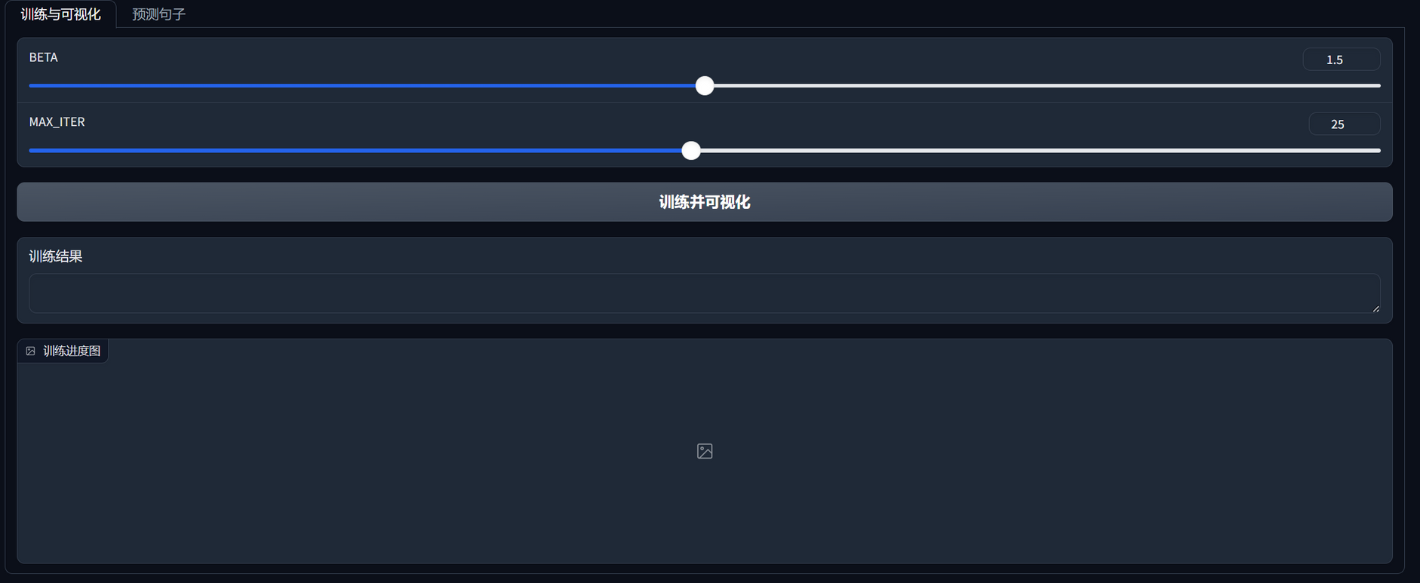
Train ui
slide
view of training process

Slide 9
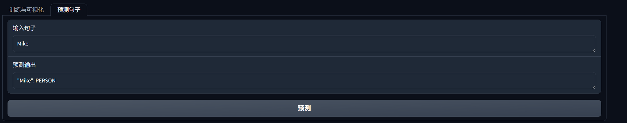
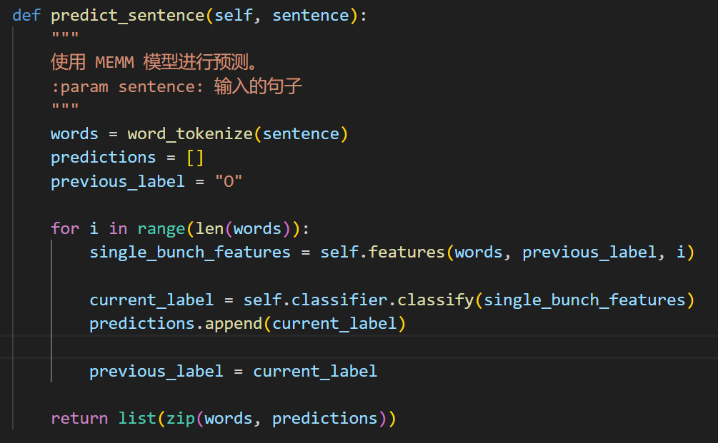
using ui
gradio train and use the best model
using nltk to split the sentence

Slide 10
-03-
CHALLENGES

Slide 11
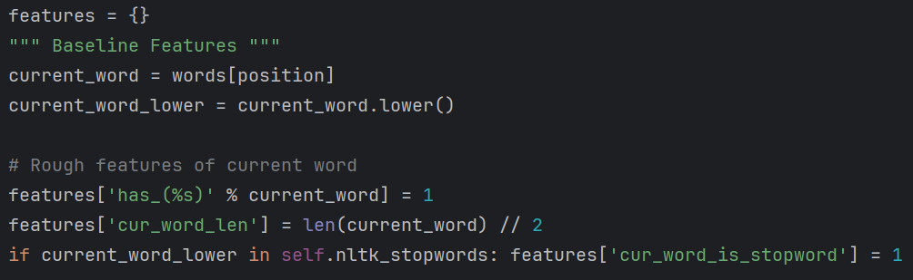
3.0 Quick glance on features design
1. Rough features of current word:
has the word?
half of the length of the current word. (deal with wrong/different spelling)
current word is stop word?

Slide 12
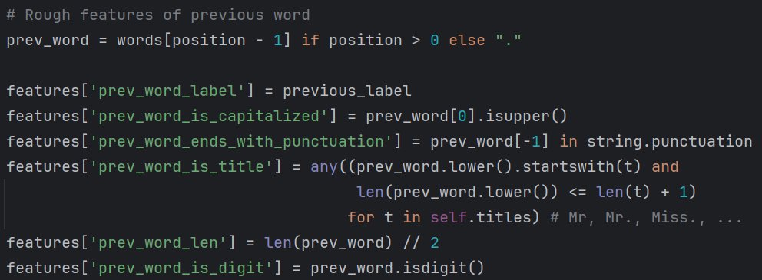
3.0 Quick glance on features design
2. Rough features of previous word:
label of previous word
previous word first letter Cap? (e.g. The, Why...)
End with punctuation? (e.g. Mr., !, 20%...)
Is title? (e.g. Mr, Mrs., Miss)
half of the length
Is digit?

Slide 13

3.0 Quick glance on features design
2. Rough features of previous word:
feature[‘has_prev_(%s)’ % prev_word] = prev_word
is not good!
Because this feature can severely reduces the generalisation ability of the model!

Slide 14
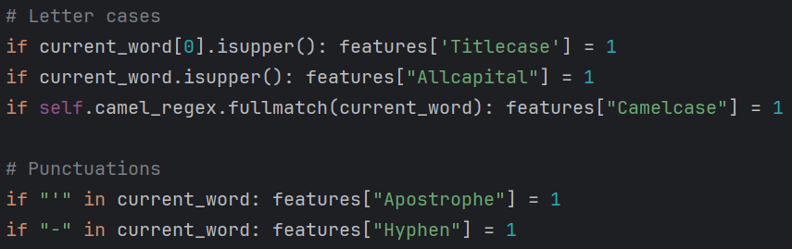
3.0 Quick glance on features design
3. Letter cases & has punctuations in current word?
Titlecase? (Hello, This)
Allcapital? (DC, TOM)
Camelcase? (iPhone, McDonald)
has - or ’ ? (Hi-Rush, O’Steven)

Slide 15
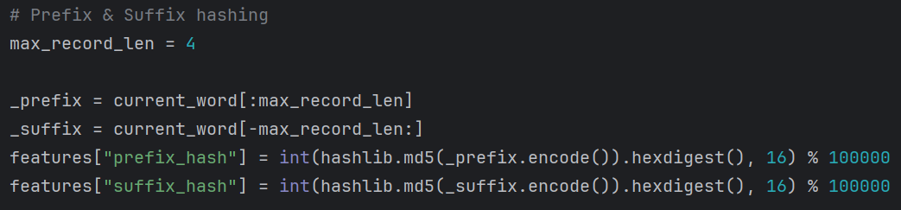
3.0 Quick glance on features design
4. Record prefix and suffix by Hashing algorithm
As directly record the prefix or suffix can cause infinity bucket problem,
We use hashing to map various prefix/suffix to integer range from 0 to 9999.

Slide 16
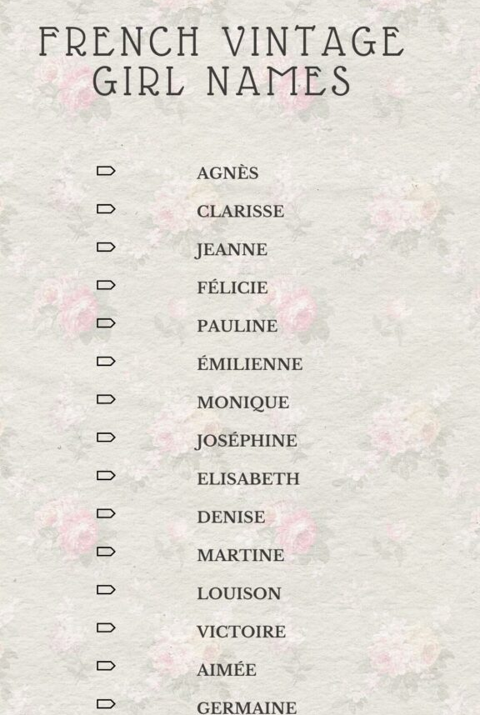
3.1 Non-English Names
French
François-Henri Pinault,
Élodie Fontaine (é, è, û)
German
FJürgen Müller, Gisela Schön
(ä, ö, ü)
Spanish
María José García, Sofía Íñiguez
(á, í, ñ)
Shen Guofang
Lyu Zhihe, HUO YINGDONG
Chinese

Slide 17
3.1 Non-English Names
For French, German and Spanish, etc.
We add up one special feature to them:
If any character is non-ASCII Latin letter, mark its feature.
@staticmethod
def is_latin_char(check_char):
try:
return unicodedata.name(check_char).startswith('LATIN')
except ValueError:
return False
...
...
if any(ord(c) > 127 and self.is_latin_char(c) for c in current_word):
features["Contain_non_ascii_latin"] = 1
...
...

Slide 18
3.1 Non-English Names
For Chinese Pinyin(拼音) names, We are concerned about the correctness of the spelling of the name, so we apply a regular method to filter Chinese Pinyin names.
self.pinyin_regex = re.compile(
r"^("
r"(a[io]?|ou?|e[inr]?|ang?|ng|[bmp](a[io]?|[aei]ng?|ei|ie?|ia[no]|o|u)|"
r"pou|me|m[io]u|[fw](a|[ae]ng?|ei|o|u)|fou|wai|[dt](a[io]?|an|e|[aeio]ng|"
r"ie?|ia[no]|ou|u[ino]?|uan)|dei|diu|[nl](a[io]?|ei?|[eio]ng|i[eu]?|i?ang?|"
r"iao|in|ou|u[eo]?|ve?|uan)|nen|lia|lun|[ghk](a[io]?|[ae]ng?|e|ong|ou|u[aino]?|"
r"uai|uang?)|[gh]ei|[jqx](i(ao?|ang?|e|ng?|ong|u)?|u[en]?|uan)|([csz]h?|"
r"r)([ae]ng?|ao|e|i|ou|u[ino]?|uan)|[csz](ai?|ong)|[csz]h(ai?|uai|"
r"uang)|zei|[sz]hua|([cz]h|r)ong|y(ao?|[ai]ng?|e|i|ong|ou|u[en]?|uan))"
r"){1,4}$"
)
self.pinyin_confusion = {"me", "ma", "bin", "fan", "long", "sun", "panda", "china"}
The confusion list is to mark the correct Pinyin that also has English meaning.

Slide 19
3.1 Non-English Names
But the Chinese letter “吕”, “绿”, or “旅”, they have 3 different spelling in various situation.
Lu, Lv, and Lyu. So, we add up one feature to record them.
if self.pinyin_regex.fullmatch(current_word.lower()):
features["Pinyin"] = 1
if current_word.lower().endswith("lyu") or current_word.lower().startswith("lyu"):
features["Pinyin_lyu"] = 1 # specialize for 吕 written in lyu
if current_word.lower() in self.pinyin_confusion:
features["Pinyin_confusion"] = 1

Slide 20
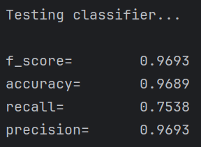
3.2 The RECALL is too low!!!
By using pure MEM, most of us might noticed that even the f1_score is pretty high, (like 0.95) but the performance is really bad - almost all words are recognized as ‘O’ including most of names.
That is because the recall is very low. We can not only focus on f1_score, but pay more attention on recall.
(The recall of model trained 7-iteration)

Slide 21
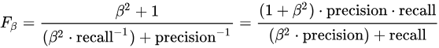
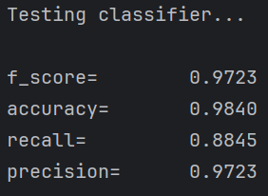
3.2 Using beta-f1 score
By but we can't put too much emphasis on Recall, therefore we use beta_f1_score to measure the performance of our model.
With this, we were able to train models that performed better.

Slide 22
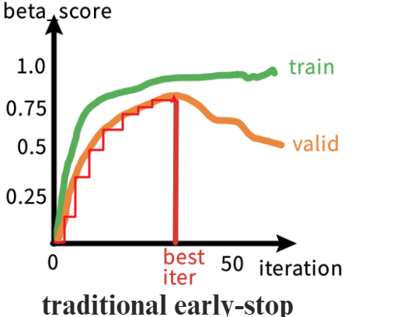
3.3 Training is too slow!!!
As MaxentClassifier() can only be called and run on a CPU and it cannot do incremental learning! So we need to train one model at a time from scratch.
If we use the traditional early-stop method to find the best model according to its valid metrics, our time complexity would be O(Kn^2).

Slide 23
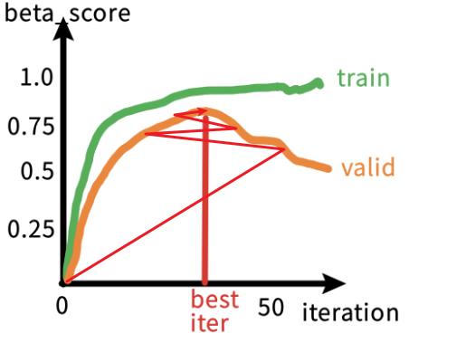
3.3 Ternary search algorithm
So we implemented a ternary search algorithm to efficiently identify the optimal number of iterations that maximizes performance on the development data.
This approach assumes that the validation metric follows a unimodal trend—initially increasing until reaching a peak before declining.
Ternary Search early- stop has Time Complexity of O(K n log n).
Ternary Search early- stop

Slide 24
3.3 Ternary Search
...
left = 0, right = 20
...
while right - left >= 3:
mid1 = left + (right - left) // 3
mid2 = right - (right - left) // 3
# Train and evaluate mid1
classifier1.train(train_samples, mid1 + 2)
metrics1 = classifier1.test()
beta_f1 = f_beta_score(metrics1['precision'], metrics1['recall'])
# Train and evaluate mid2
classifier2.train(train_samples, mid2 + 2)
metrics2 = classifier2.test()
beta_f2 = f_beta_score(metrics2['precision'], metrics2['recall']
Ternary Search early- stop

Slide 25
3.3 Ternary Search
# Update the best model
if beta_f1 > best_score:
best_score = beta_f1
best_iter = mid1 + 2
best_classifier = copy.deepcopy(classifier1.classifier)
if beta_f2 > best_score:
best_score = beta_f2
best_iter = mid2 + 2
best_classifier = copy.deepcopy(classifier2.classifier)
# Narrow the search range
if beta_f1 < beta_f2:
left = mid1
else:
right = mid2
# Final evaluation (optional: fine-tune in the remaining range)
classifier.best_classifier = best_classifier
classifier.save_model(classifier.best_classifier)
Ternary Search early- stop

Slide 26
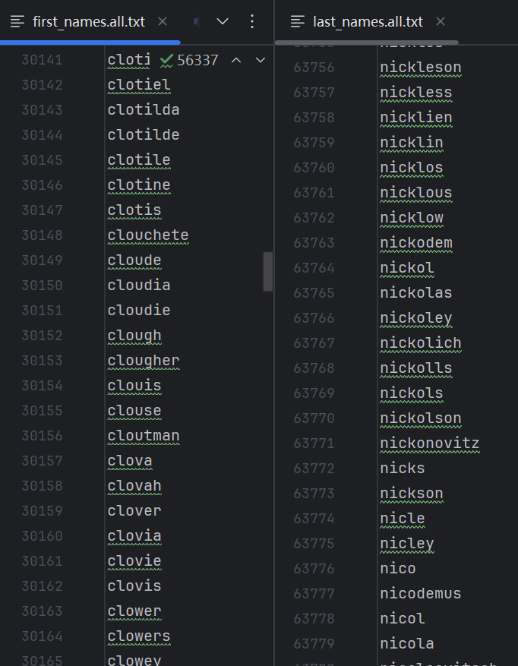
3.4 The training set given is too small!!
To address the limited coverage of the given training set for multilingual name identification, we constructed two comprehensive gazetteers:
Latin Script Gazetteer
Contains ~160k first names, ~100k last names (e.g., Smith, García, Muhammad)
Sources: names.io(https://github.com/Debdut/names.io/)
Covers 18 languages using Latin script (English, Spanish, Arabic transliterations, etc.)

Slide 27
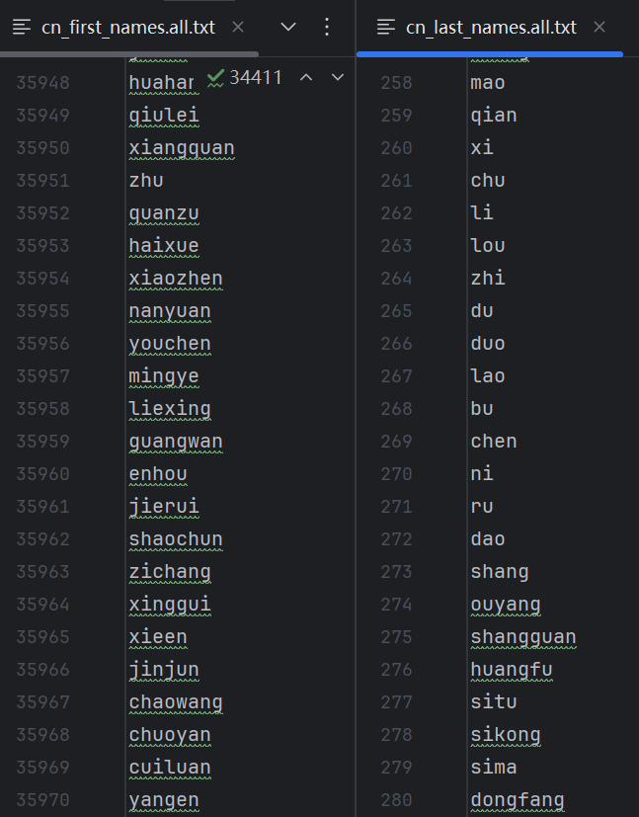
3.4 The training set given is too small!!
To address the limited coverage of the given training set for multilingual name identification, we constructed two comprehensive gazetteers:
2. Chinese Pinyin Gazetteer
Includes 35k+ common names and 308 family names:
Compound surnames (复姓, e.g., Ōuyáng 欧阳, Sīmǎ 司马)
Sources: 中文人名语料库(https://github.com/wainshine/Chinese-Names-Corpus)

Slide 28
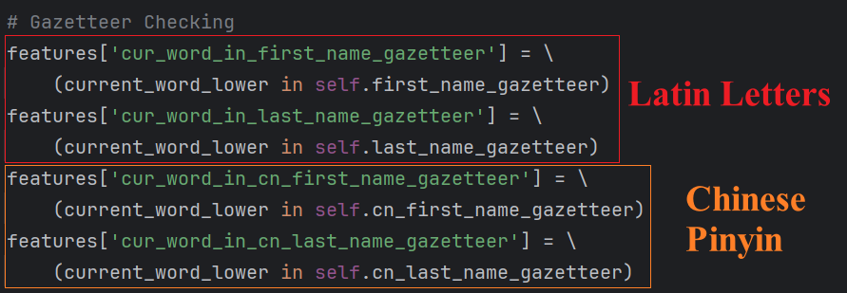
3.4 The training set given is too small!!
After building 2 gazetteers, we add up 4 features for model to better identify the names:

Slide 29
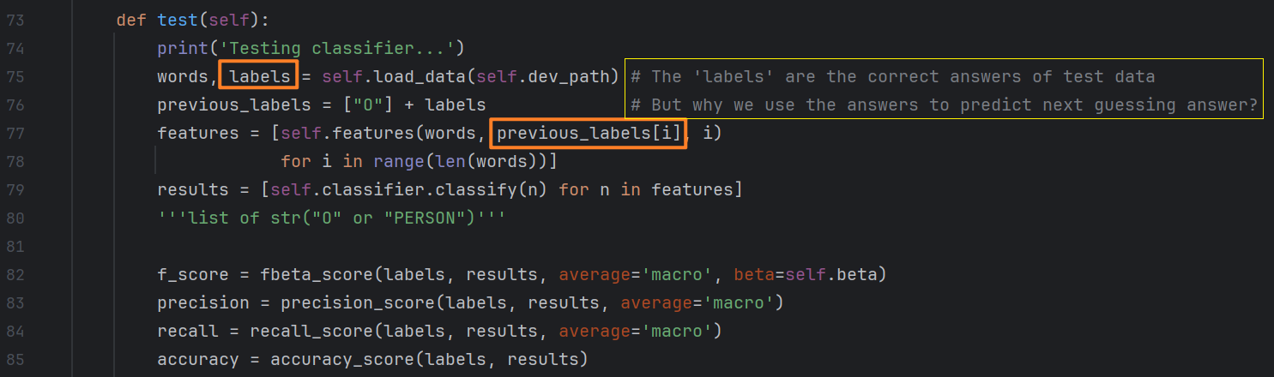
3.5 additional mentioned...
The original test method in MEM.py (provided on Moodle) was incorrect because it used the true label of the previous word to predict the current word’s label.

Slide 30
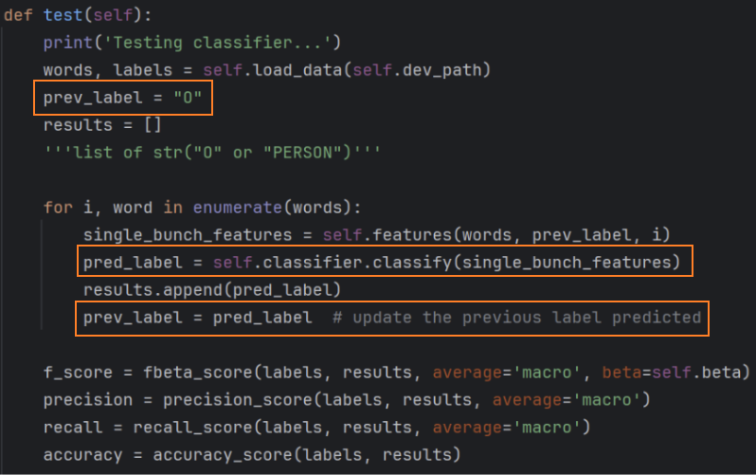
3.5 additional mentioned...
To fix this, we rewrote the method so that it predicts each label based on the previously predicted label instead.

Slide 31
-04-
PRESENTATION & CONCLUSION

Slide 32
4.0 presentation on web

Slide 33
4.1 Conclusion
In this project, our group designed features from the perspective of different languages and optimized the training logic to improve training efficiency, fully leveraging the advantages of MEMM in NER.
The final model achieved excellent results (shown in figure below) and proved effective in recognizing pinyin names and Latin variant names.
For the web interface, we used Gradio and called Python scripts to enable better interaction.

Slide 34


Thank you!

